Slide 1
Session 17 : Fonts
Module 4.3 : Android

Slide 2
Learning Objectives
At the end of the session successful participants will be able to
Describe android fonts.
Use predefined fonts
Create and use custom fonts

Slide 3

Fonts
Fonts in Android

Slide 4
Fonts
Fonts in Android
Android naturally provides three fonts:
sans
An m is wider than i, mmm iiii
serif
An m is wider than i, mmm iiii
monospaced
An mmm is not wider than iii

Slide 5
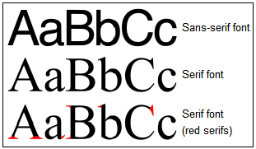
Fonts
Fonts in Android
Also known as:
Grotesque or Gothic
Roman Type

Slide 6
Fonts
Fonts in Android
Developers may add any font to their application by following the next steps:
Create the /fonts folder in the /assets directory.
Copy any fonts you plan to use into the new folder.
Use Java code to bind the font with the UI widget wanting to display the custom typeface (see example) example).

Slide 7
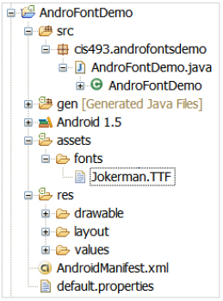
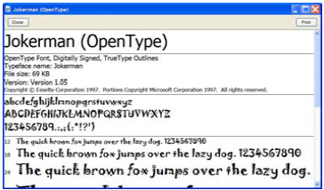
Fonts
Menus in Android: Example
Getting ready to use the Jokerman.TTF font.
Original font taken from c:\Windows\Fonts

Slide 8
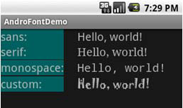
Fonts
Menus in Android: Example
Display the Hello World ! message using different fonts.
Using the font: Jokerman.TTF
Note:
If you are using Windows XP look into the folder: c:\Windows\Fonts for fonts installed in your machine.
Consult the page: http://www.ascendercorp.com/support/windows/ for additional information in manipulating fonts.

Slide 9
Fonts
Menus in Android: Example
Applications: Showing different FONT types
<?xml version="1.0" encoding="utf-8"?>
<TableLayout
android:id="@+id/myTableLayout"
android:layout_width="fill_parent"
android:layout_height="fill_parent"
android:orientation="vertical"
android:stretchColumns="1"
xmlns:android="http://schemas.android.com/apk/res/android"
>

Slide 10
Fonts
Menus in Android: Example
Applications: Showing different FONT types
<TableRow
android:id="@+id/myRow1"
android:layout_width="fill_parent"
android:layout_height="wrap_content"
android:orientation="horizontal"
>
<TextView
android:id="@+id/labelSans"
android:layout_width="wrap_content"
android:layout_height="wrap_content"
android:background="#ff006666”

Slide 11
Fonts
Menus in Android: Example
Applications: Showing different FONT types
android:layout_marginRight="24px"
android:text="sans:"
android:textSize="20sp"
>
</TextView>
<TextView
android:id="@+id/sans"
android:layout_width="wrap_content"
android:layout_height="wrap_content"
android:text="Hello, world!”

Slide 12
Fonts
Menus in Android: Example
Applications: Showing different FONT types
android:textSize="20sp"
android:typeface="sans"
>
</TextView>
</TableRow>
<TableRow
android:id="@+id/myRow3"
android:layout_width="fill_parent"
android:layout_height="wrap_content"
android:orientation="horizontal"
>

Slide 13
Fonts
Menus in Android: Example
Applications: Showing different FONT types
<TextView
android:id="@+id/labelMonospace"
android:layout_width="wrap_content"
android:layout_height="wrap_content"
android:layout_marginRight="24px"
android:text="monospace:"
android:textSize="20sp"
android:background="#ff006666"
>
</TextView>
<TextView

Slide 14
Fonts
Menus in Android: Example
Applications: Showing different FONT types
android:id="@+id/monospace"
android:layout_width="wrap_content"
android:layout_height="wrap_content"
android:text="Hello, world!"
android:textSize="20sp"
android:typeface="monospace"
>
</TextView>
</TableRow>

Slide 15
Fonts
Menus in Android: Example
Applications: Showing different FONT types
<TableRow
android:id="@+id/myRow4"
android:layout_width="fill_parent"
android:layout_height="wrap_content"
android:orientation="horizontal"
>
<TextView
android:id="@+id/labelCustom"
android:layout_width="wrap_content"
android:layout_height="wrap_content"
android:layout_marginRight="24px”

Slide 16
Fonts
Menus in Android: Example
Applications: Showing different FONT types
android:text="custom:"
android:textSize="20sp"
android:background="#ff006666"
>
</TextView>
<TextView To be displayed using a custom font
android:id="@+id/custom"
android:layout_width="wrap_content"
android:layout_height="wrap_content"
android:text="Hello, world!”

Slide 17
Fonts
Menus in Android: Example
Applications: Showing different FONT types
android:textSize="20sp"
>
</TextView>
</TableRow>
</TableLayout>

Slide 18
Fonts
Menus in Android: Example
Applications: Showing different FONT types
package cis493.androfontsdemo;
import android.app.Activity;
import android.graphics.Typeface;
import android.os.Bundle;
import android.widget.TextView;
public class AndroFontDemo extends Activity {
@Override
public void onCreate(Bundle icicle) {
super.onCreate(icicle);
setContentView(R.layout.main);

Slide 19
Fonts
Menus in Android: Example
Applications: Showing different FONT types
// bind the "custom" textview with chosen font
custom TextView tvCustom=(TextView)findViewById(R.id.custom);
Typeface myNewFace=Typeface.createFromAsset(
getAssets(), "fonts/Jokerman.TTF“ );
tvCustom.setTypeface(myNewFace);
}
}

